Slide 1
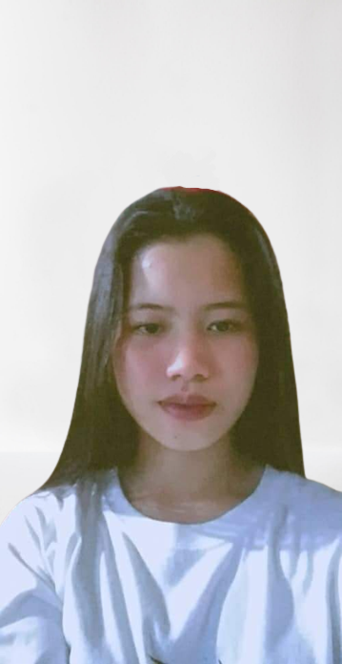
EDUCATIONAL
PRIMARY 2006-2014 : Lajong Elementary School
SECONDARY 2014-2017 : Matnog National High School
SENIOR HIGH 2017-2019 : Matnog National High Schoo
TERTIARY PRESENT : Sorsogon State university-Bulan campus
Alyanna mae Garbida
CONTACT
Address :
Lajong Matnog Sorsogon
WORK EXPERIENCE
Phone:
+639203926938
Waitress : Mang sebio tapsilogan farmers cubao
Email:
alyannagarbida281@gmail.com
SKILLS
HTML 25%
CSS 20%
JAVA 30%
JAVASCRIPT 20%

